Slide 1
Project 1.4: Hydrogenation of dilute nitrides for single photon emitters in photonic crystals
Saeed Younis

Slide 2
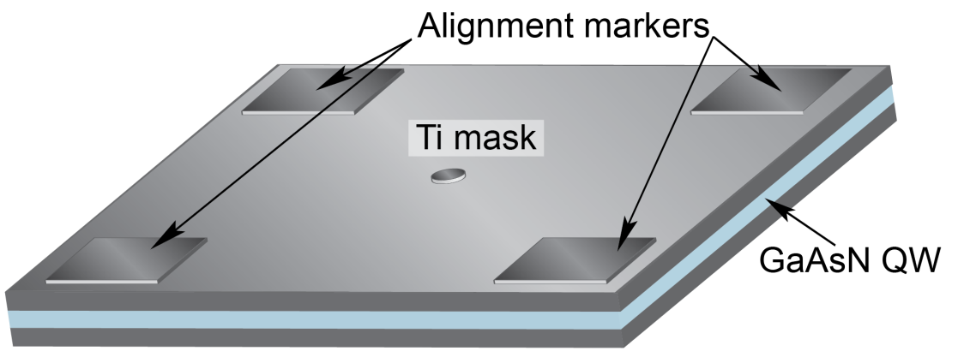
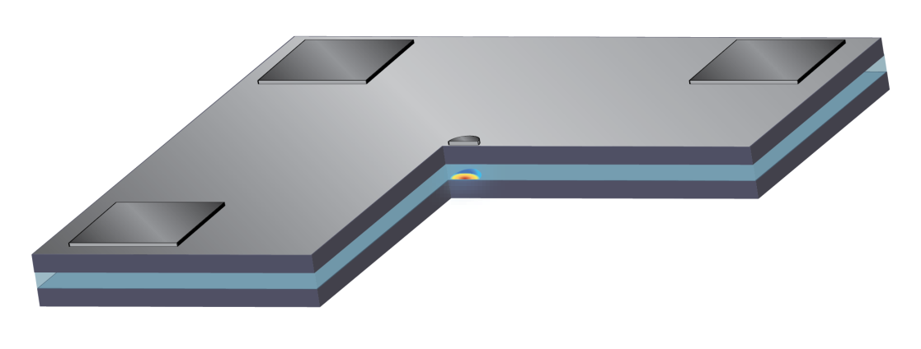
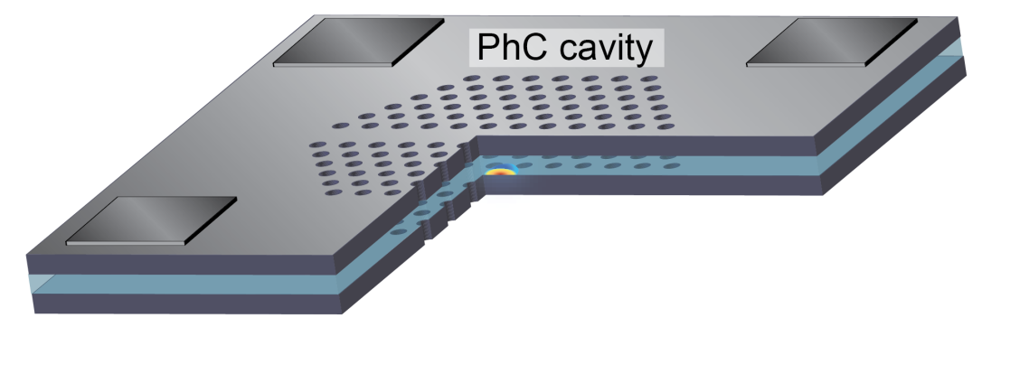
Roadmap to Goal
The way we plan to achieve high intensity single-photon emitters working at 1.3 um:
Obtain high-quality, uniform, N-containing QWs
Emitting bellow 1 eV
Can be hydrogenated
Engineer the dot size and hydrogen dose to achieve the most suitable quantum confinement
Single-peak PL at 1.3 um
Integrate a PhC Cavity around the dot
Yet better confinement through energy-locking of wandering dots
Enhances the intensity through reduction of the spontaneous emission rate

Slide 3
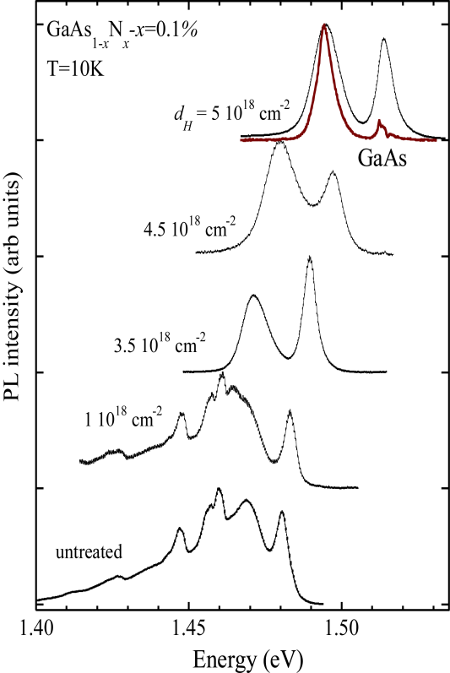
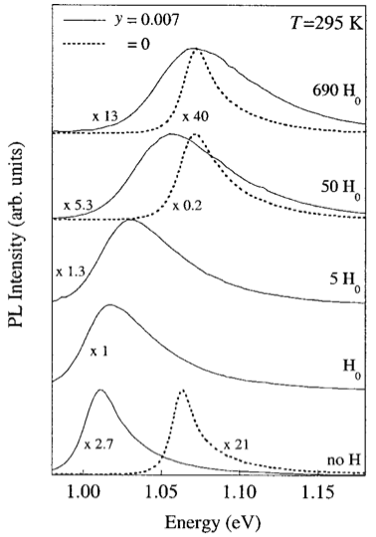
Effects of Hydrogenation on (In)GaAsN
For both GaAsN and InGaAsN, most effects are similar:
Hydrogenation leads to blue-shifting of the peaks
This is due to the passivation of N complexes
Can lead to full recovery of the band gap energy to values of N-free material
This effect is observed only when N is present in the material
It also leads to reduction of PL intensity
Luckily, hydrogenation is performed outside the dot
A. Polimeni et al., PRB 63, 201304 (2001).
M. Bissiri et al., PRB 65, 235210 (2002).

Slide 4
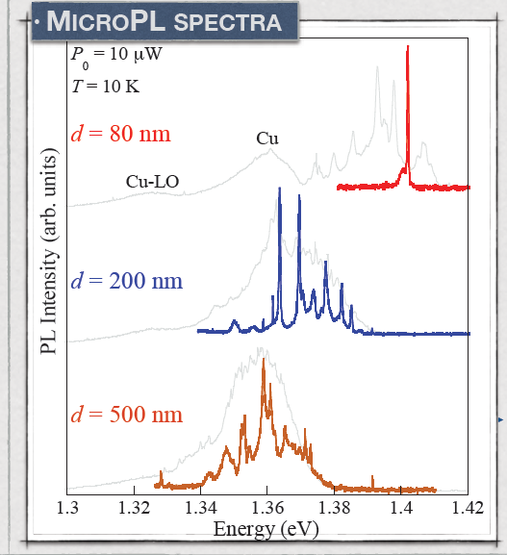
GaAsN Quantum Dots
For sufficiently small mask sizes
Quantum confinement achieved
One single peak with < 150 uW FWHM
Variation between identical dots is on the order of only ~10 meV !
Their emission falls within ~40 meV
BUT the starting uniformity of the QW was ~30 meV
S. Birindelli, M. Felici, et al., Nano Lett. 14, 1275 (2014).

Slide 5
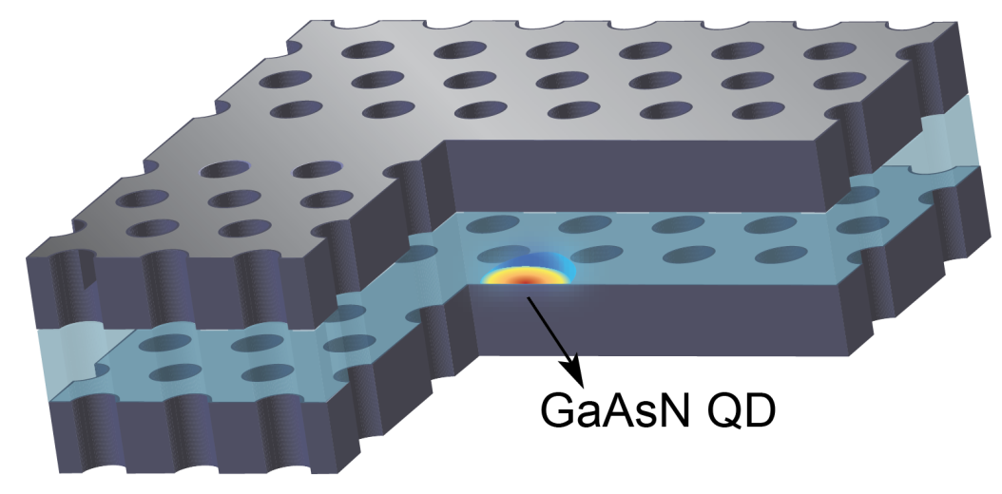
PhC Cavity in GaAsN
Suspended membrane of GaAs with a GaAsN / GaAsN:H dot inside
Holes are fabricated with RIE
AlGaAs sacrificial layer removed through chemical etching
500 nm
5 µm
200 nm
Courtesy of G. Pettinari, IFN-CNR
GaAs
GaAsN QW
GaAs
AlGaAs

Slide 6
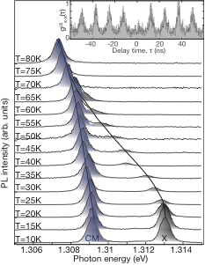
Coupling to the PhC Cavity Mode
For various cavity designs
Close matching at low temperature was achieved between QDs and the principal cavity mode (CM)
~5meV mismatch at 10K
Relative increase in the signal was observed when the QD mode approached the CM
Between 50-70 K, one can see an increase in intensity despite the general trend of the intensity getting lower due to higher temperature

Slide 7
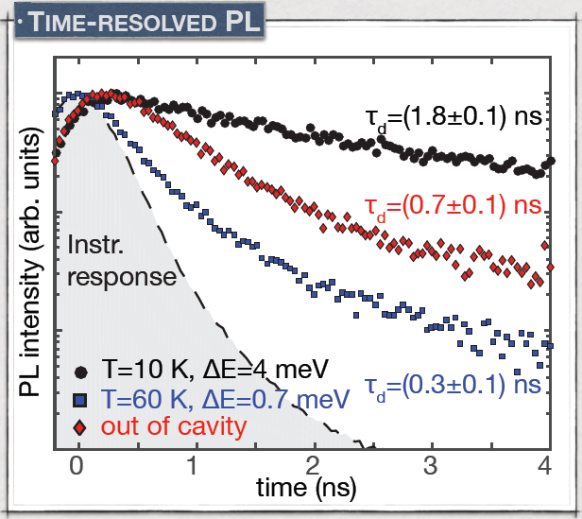
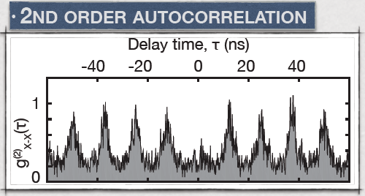
Time-Correlated PL Measurements
For various cavity designs
The spontaneous emission could be tuned based on the proximity of the QD’s mode to the CM
Inhibited when modes are far (black dots)
Enhanced when modes are adjacent (blue dots)
Photon Antibunching observed
→ single-photon emitter !!
mask size
d=160 nm

Slide 8
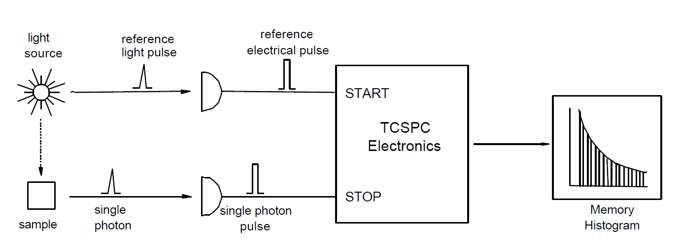
Explanation of TCSPC Techniques
Time-resoloved PL
Second-order auto-correlation

